Slide 1

Monte Carlo/Dynamic Code: Performant and Portable High-Performance Computing at Scale via Python and Numba
Joanna Piper Morgan* & Kyle E. Niemeyer
The Center for Exascale Monte Carlo Neutron Transport (CEMeNT) † at Oregon State University
*morgajoa@oregonstate.edu
†https://cement-psaap.github.io/
23rd Conference on Scientific Computing in Python (SciPy 2024)
Tacoma, WA, USA
Wednesday, July 9th, 2024
This work was supported by the Center for Exascale Monte Carlo Neutron Transport (CEMeNT) a PSAAP-III project funded by the Department of Energy, grant number: DE NA003967.

Slide 2








Advancing the state of the art of Monte Carlo neutronics calculations particularly for solving time-dependent transport problems on exascale computer architectures in a sustainable open-source community

Slide 3

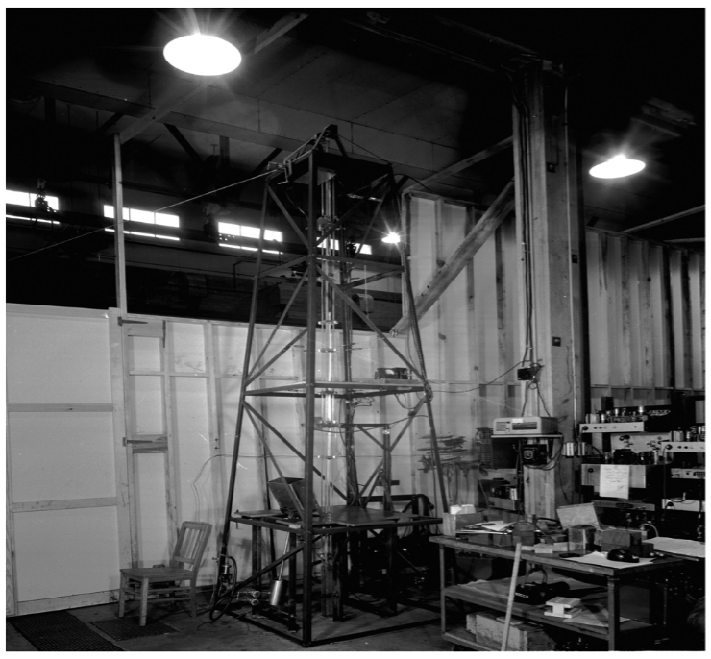
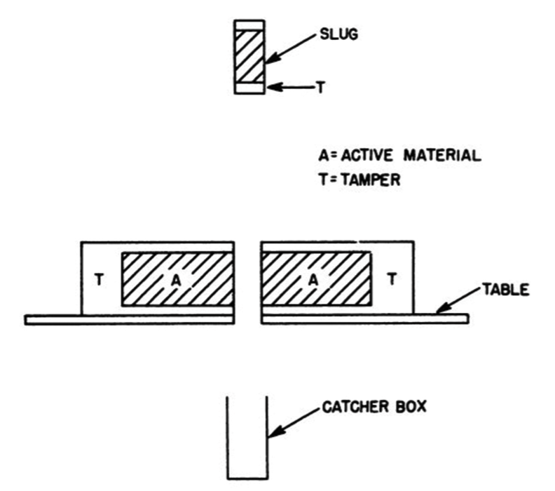
Dragon Burst Experiment
Kimpland, Robert, et al. "Critical assemblies: Dragon burst assembly and solution assemblies." Nuclear Technology207.sup1 (2021)
Slides courtesy of Ilham Variansyah
3

Slide 4
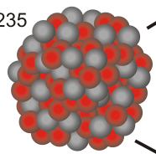
Fission Chain Reaction
ENERGY
n
Daughter Element
ENERGY
ENERGY
n
n
ENERGY
n
ENERGY
n
n
ENERGY
Daughter Element
ENERGY
n

Slide 5
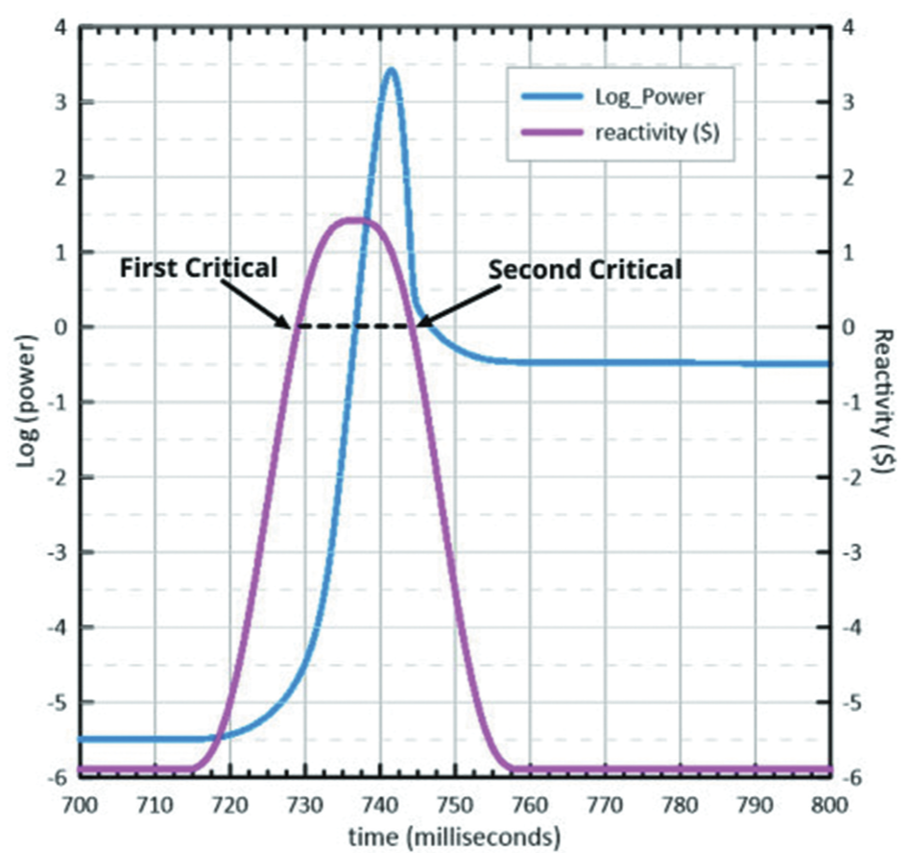
Dragon Burst Experiment
Nine orders of
magnitude burst!
Kimpland, Robert, et al. "Critical assemblies: Dragon burst assembly and solution assemblies." Nuclear Technology207.sup1 (2021)
Slides courtesy of Ilham Variansyah

Slide 6
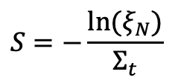
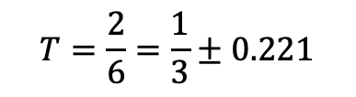

Monte Carlo Algorithm: Transmittance
S
S
N = 6
N = 0
N = 1
N = 2
Transmitted (S>L)
n
Absorbed (S<L)
$$Σ_{t}$$
L
$$S=−\frac{ln⁡(ξ_{N})}{Σ_{t}}$$
$$T=\frac{2}{6}=\frac{1}{3}±0.221$$
Notes:
The difficulty
No linalg
we can run each particle independent of every other particle

Slide 7
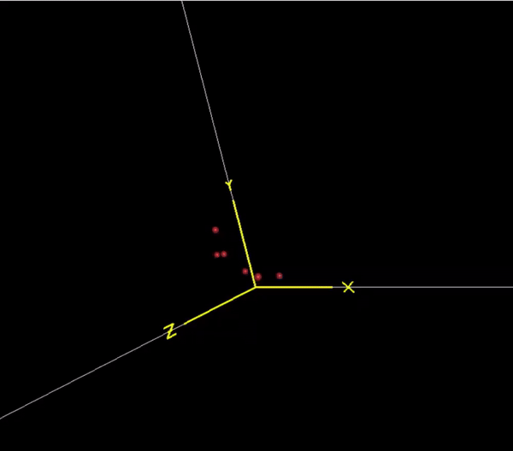

Monte Carlo / More Complexly
Imagine if:
neutrons could all be going at different speeds
traveling in 3 spatial dimensions
geometry changing thru time
more complex tallies then transmittance
neutrons produced from fission reactions or source regions
multi-material systems
error propagation
temperature dependent systems

Slide 8
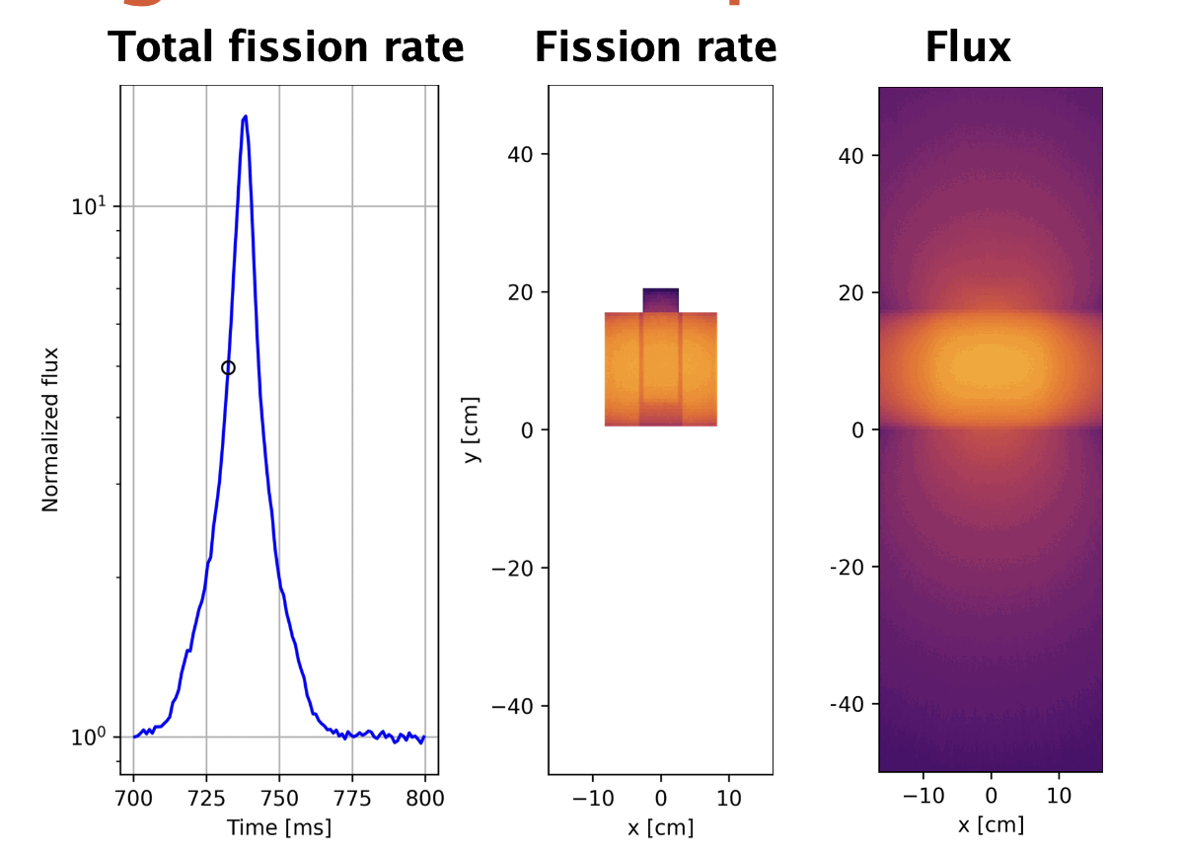
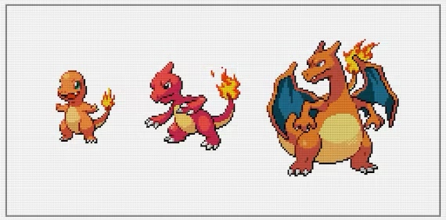
Dragon Burst Experiment
GIF removed for size constraint
Burst level
10x
10⁵x
10⁹x
Slides courtesy of Ilham Variansyah

Slide 9
Major take aways
No linear algebra, physics happens at the kernel
Each particle history is independent of every other particle
Solutions always have a statistical error
Converges very slowly
We’ll need every FLOP we can get!

Slide 10


MC/DC at HPC
Modern HPC’s use lots of GPUs
We need to produce compute kernels for both CPUs and GPUs
Portability frameworks have entered the chat
Kokkos/Raja
DSLs + Python Glue
Julia*
Numba
mpi4py
Notes:
Why monte carlo needs the exascale

Slide 11
MC/DC Layout
user_defined_input.py
input_.py
main.py
output.h5
MPI Thread: 0 Numba/Python mode
MPI Thread: 1 Numba/Python mode
MPI Thread: N Numba/Python mode
…
loop.py decorated python functions
loop.py decorated python functions
loop.py decorated python functions
Python
kernel.py decorated python functions
kernel.py decorated python functions
kernel.py decorated python functions
Compiled

Slide 12
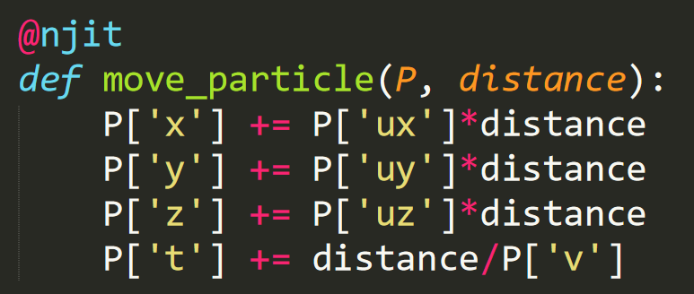
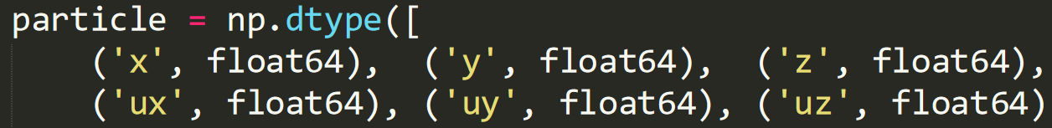
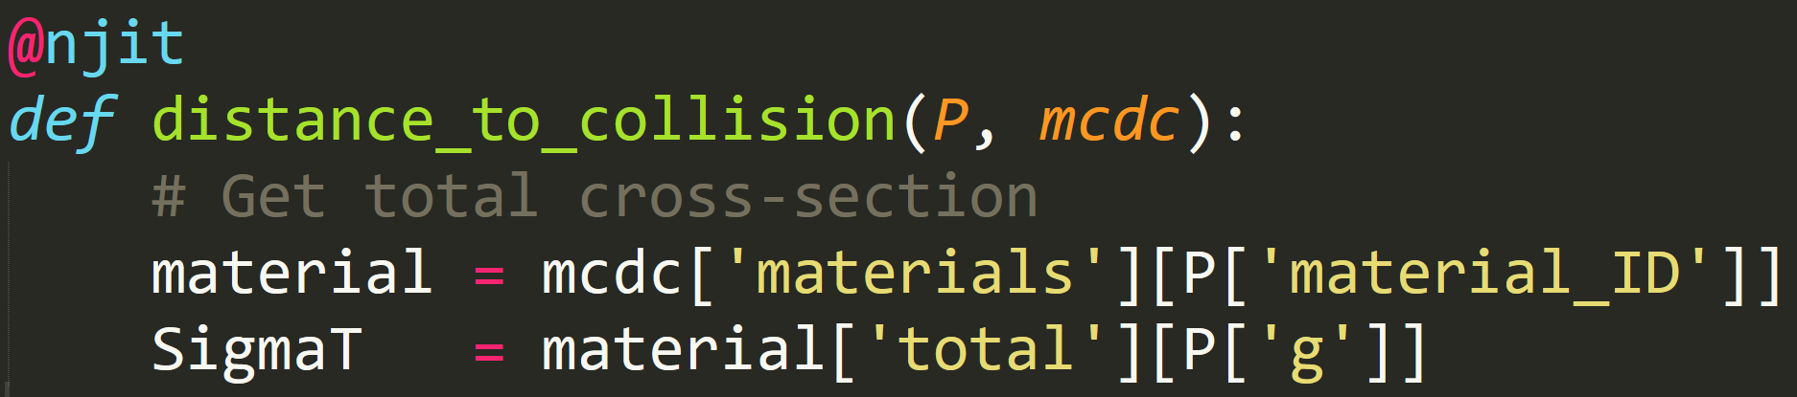
Monte Carlo/Dynamic Code (MC/DC)
Add @jit decorator to all functions
Overhead is expected, but negligible for large problem
Extensively use NumPy structured array for particle, cell, material, etc.
Numpy structured scalar is used as global variable container

Slide 13
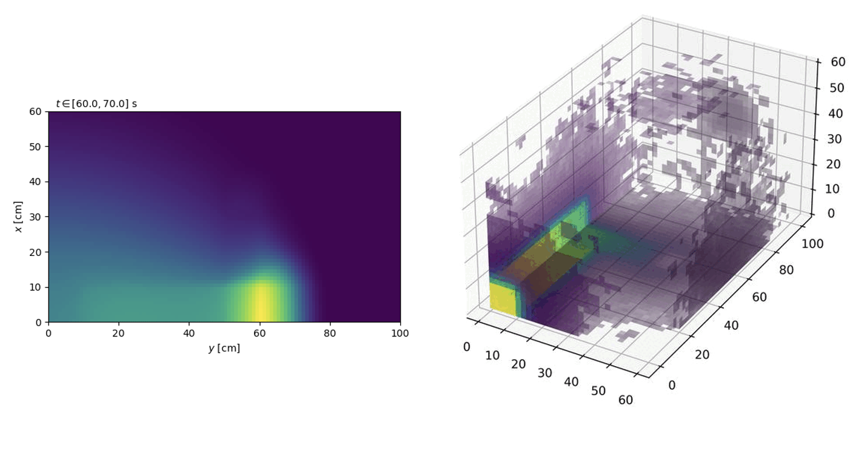
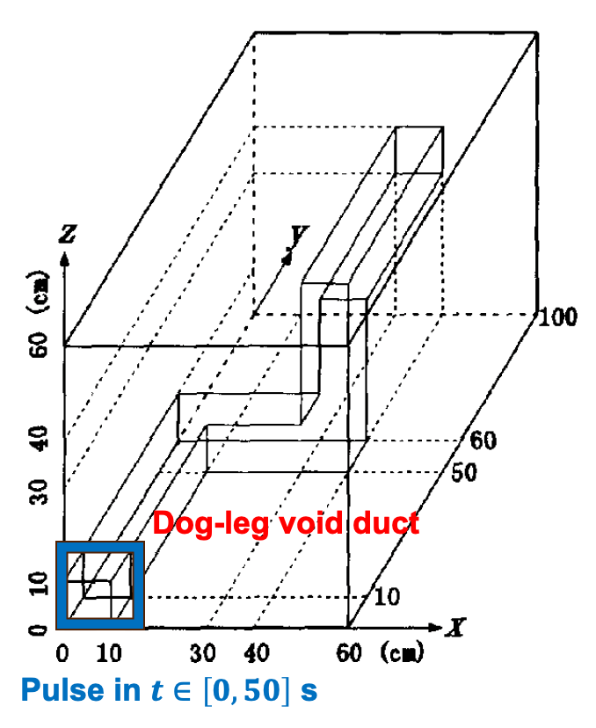
Time-dependent Kobayashi dog-leg benchmark
GIF removed for size constraint
K. Kobayashi, “3-D Radiation Transport Benchmarks for Simple Geometries with Void Regions,” OECD/NEA report

Slide 14
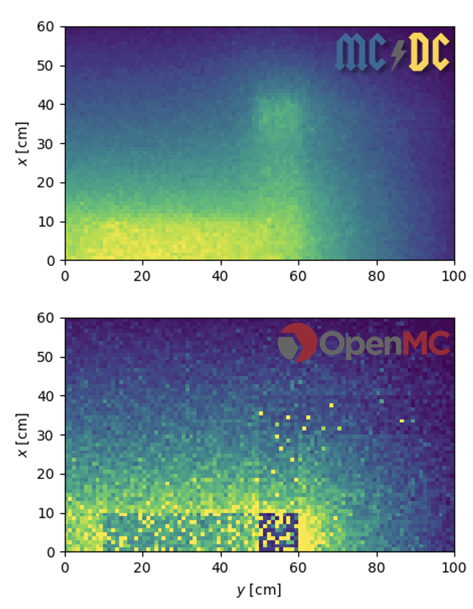
OpenMC vs MC/DC
GIF removed for size constraint
 | Runtime* [min] | FOM**
MC/DC | 22.27 (13.3x) | 2.24 (770x)
MC/DC (new) | 6.81 (4.1x) | 7.32 (2520x)
OpenMC | 1.67 | 0.0029
*Run with 10 batches and 10⁷ particles/batch on 36 cores
**Based on error 2-norm, with MC/DC 10⁹ particles/batch as reference

Slide 15
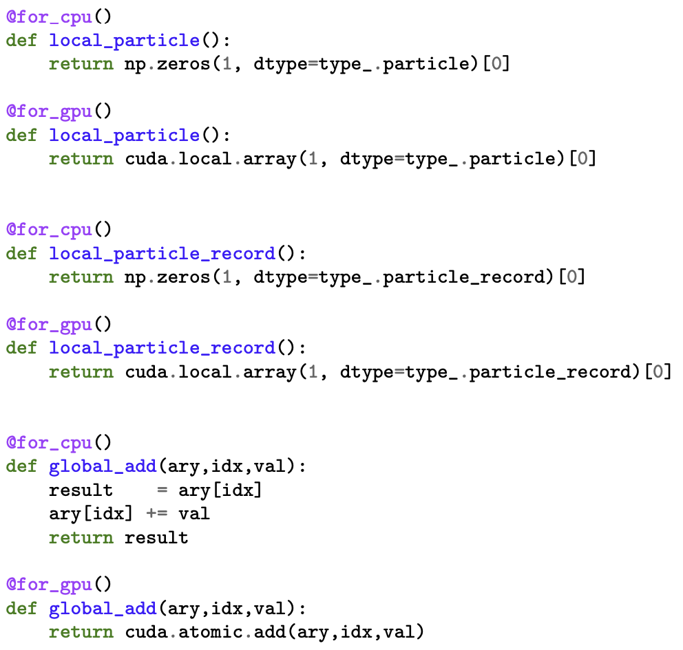
GPU Implementation of MC/DC
Python abstractions to abstract hardware arch
Turbocharging performance via Harmonize
A-sync GPU scheduler
Effectively on the fly event-based
Harmonize Repo: github.com/CEMeNT-PSAAP/harmonize
Tomorrow, 16:30–17:00, Ballroom: Dante’s Externo: Injecting Python Functions into a Template-Driven CUDA C++ Framework, Braxton Cuneo

Slide 16
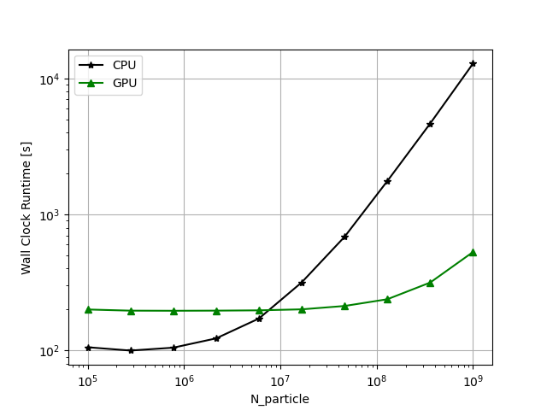
MC/DC CPU v MC/DC GPU
Kobayashi-monoenergetic CPU Intel Xeon E5-2695, 36 cores/node
GPU 1 Nvidia Tesla V100
GPU speedup ~21-24 times

Slide 17
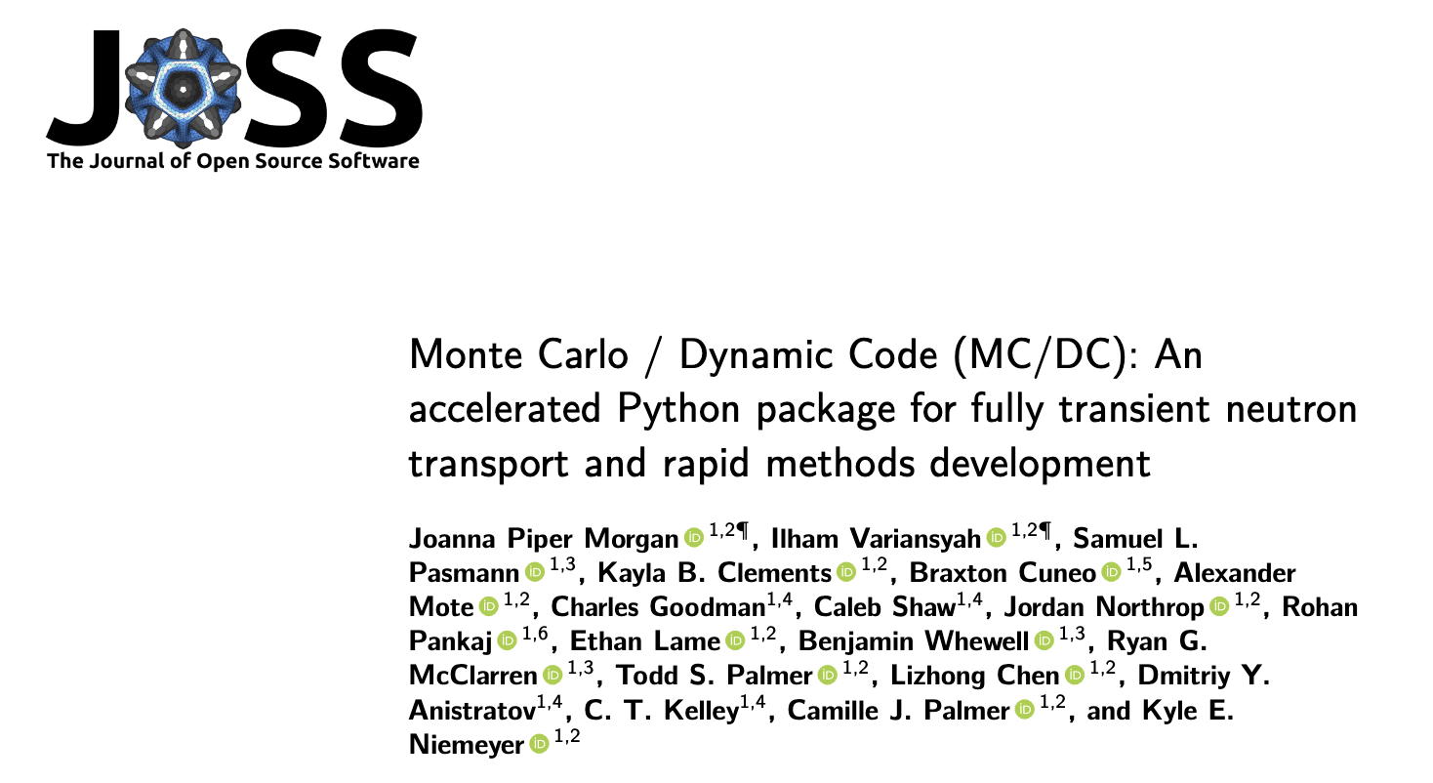
Publications that Force Good Development
DOI: 10.2205/joss.06415

Slide 18
Limitations of Numba
Unsupported C-side functions (MPI, memalloc)
Undocumented IR generation behavior
Long compile times
Lacking ahead of time compilation
Lack of compiled kernel profiling on CPUs or GPUs
Cryptic compiler errors

Slide 19
Traceback (most recent call last):
File "/home/joamorga/workspace/MCDC/examples/fixed_source/slab_absorbium/input.py", line 48, in <module>
mcdc.run()
File "/home/joamorga/workspace/MCDC/mcdc/main.py", line 61, in run
mcdc = prepare()
^^^^^^^^^
File "/home/joamorga/workspace/MCDC/mcdc/main.py", line 191, in prepare
build_gpu_progs()
File "/home/joamorga/workspace/MCDC/mcdc/loop.py", line 1208, in build_gpu_progs
process_sources = make_gpu_process_sources(False)
^^^^^^^^^^^^^^^^^^^^^^^^^^^^^^^
File "/home/joamorga/workspace/MCDC/mcdc/loop.py", line 1112, in make_gpu_process_sources
spec = adapt.harm.RuntimeSpec(spec_name,adapt.state_spec,base_fns,async_fns)
^^^^^^^^^^^^^^^^^^^^^^^^^^^^^^^^^^^^^^^^^^^^^^^^^^^^^^^^^^^^^^^^^^^^^
File "/home/joamorga/workspace/harmonize/harmonize.py", line 1100, in __init__
self.generate_code()
File "/home/joamorga/workspace/harmonize/harmonize.py", line 1564, in generate_code
ptx_text = extern_device_ptx(fn,self.type_map)
^^^^^^^^^^^^^^^^^^^^^^^^^^^^^^^^^^^
File "/home/joamorga/workspace/harmonize/harmonize.py", line 636, in extern_device_ptx
ptx_text, res_type = device_ptx(func)
^^^^^^^^^^^^^^^^
File "/home/joamorga/workspace/harmonize/harmonize.py", line 121, in device_ptx
ptx, res_type = cuda.compile_ptx_for_current_device(func,fn_arg_ano(func),device=True,debug=DEBUG,opt=(not DEBUG))
^^^^^^^^^^^^^^^^^^^^^^^^^^^^^^^^^^^^^^^^^^^^^^^^^^^^^^^^^^^^^^^^^^^^^^^^^^^^^^^^^^^^^^^^^^^^^^^^^^
File "/home/joamorga/miniconda3/envs/hip/lib/python3.11/site-packages/numba/hip/compiler.py", line 423, in compile_llvm_ir_for_current_device
return compile_llvm_ir(
^^^^^^^^^^^^^^^^
File "/home/joamorga/miniconda3/envs/hip/lib/python3.11/site-packages/numba/core/compiler_lock.py", line 35, in _acquire_compile_lock
return func(*args, **kwargs)
^^^^^^^^^^^^^^^^^^^^^
File "/home/joamorga/miniconda3/envs/hip/lib/python3.11/site-packages/numba/hip/compiler.py", line 354, in compile_llvm_ir
cres: CompileResult = compile_hip(
^^^^^^^^^^^^
File "/home/joamorga/miniconda3/envs/hip/lib/python3.11/site-packages/numba/core/compiler_lock.py", line 35, in _acquire_compile_lock
return func(*args, **kwargs)
^^^^^^^^^^^^^^^^^^^^^
File "/home/joamorga/miniconda3/envs/hip/lib/python3.11/site-packages/numba/hip/compiler.py", line 262, in compile_hip
cres = compiler.compile_extra(
^^^^^^^^^^^^^^^^^^^^^^^
File "/home/joamorga/miniconda3/envs/hip/lib/python3.11/site-packages/numba/core/compiler.py", line 770, in compile_extra
return pipeline.compile_extra(func)
^^^^^^^^^^^^^^^^^^^^^^^^^^^^
File "/home/joamorga/miniconda3/envs/hip/lib/python3.11/site-packages/numba/core/compiler.py", line 461, in compile_extra
return self._compile_bytecode()
^^^^^^^^^^^^^^^^^^^^^^^^
File "/home/joamorga/miniconda3/envs/hip/lib/python3.11/site-packages/numba/core/compiler.py", line 529, in _compile_bytecode
return self._compile_core()
^^^^^^^^^^^^^^^^^^^^
File "/home/joamorga/miniconda3/envs/hip/lib/python3.11/site-packages/numba/core/compiler.py", line 508, in _compile_core
raise e
File "/home/joamorga/miniconda3/envs/hip/lib/python3.11/site-packages/numba/core/compiler.py", line 495, in _compile_core
pm.run(self.state)
File "/home/joamorga/miniconda3/envs/hip/lib/python3.11/site-packages/numba/core/compiler_machinery.py", line 368, in run
raise patched_exception
File "/home/joamorga/miniconda3/envs/hip/lib/python3.11/site-packages/numba/core/compiler_machinery.py", line 356, in run
self._runPass(idx, pass_inst, state)
File "/home/joamorga/miniconda3/envs/hip/lib/python3.11/site-packages/numba/core/compiler_lock.py", line 35, in _acquire_compile_lock
return func(*args, **kwargs)
^^^^^^^^^^^^^^^^^^^^^
File "/home/joamorga/miniconda3/envs/hip/lib/python3.11/site-packages/numba/core/compiler_machinery.py", line 311, in _runPass
mutated |= check(pss.run_pass, internal_state)
^^^^^^^^^^^^^^^^^^^^^^^^^^^^^^^^^^^
^^^^^^^^^^^^^^^^^^^^^^^^^^^^^^^^^^^
File "/home/joamorga/miniconda3/envs/hip/lib/python3.11/site-packages/numba/core/compiler_machinery.py", line 273, in check
mangled = func(compiler_state)
^^^^^^^^^^^^^^^^^^^^
File "/home/joamorga/miniconda3/envs/hip/lib/python3.11/site-packages/numba/core/typed_passes.py", line 110, in run_pass
typemap, return_type, calltypes, errs = type_inference_stage(
^^^^^^^^^^^^^^^^^^^^^
File "/home/joamorga/miniconda3/envs/hip/lib/python3.11/site-packages/numba/core/typed_passes.py", line 91, in type_inference_stage
errs = infer.propagate(raise_errors=raise_errors)
^^^^^^^^^^^^^^^^^^^^^^^^^^^^^^^^^^^^^^^^^^
File "/home/joamorga/miniconda3/envs/hip/lib/python3.11/site-packages/numba/core/typeinfer.py", line 1086, in propagate
raise errors[0]
numba.core.errors.TypingError: Failed in hip mode pipeline (step: nopython frontend)
No implementation of function Function(<function do_nothing_12 at 0x7fd11f3d02c0>) found for signature:
>>> do_nothing_12(nestedarray(int64, (1,)), Literal[int](0), Literal[int](1))
There are 2 candidate implementations:
- Of which 1 did not match due to:
Overload in function 'jit_func': File: ../../../../../../workspace/MCDC/examples/fixed_source/slab_absorbium/<string>: Line 0.
With argument(s): '(nestedarray(int64, (1,)), int64, int64)':
Rejected as the implementation raised a specific error:
TypingError: Failed in hip mode pipeline (step: nopython frontend)
No implementation of function Function(<class 'numba.hip.typing_lowering.hipdevicelib.hipsource.add'>) found for signature:
>>> add(nestedarray(int64, (1,)), int64, int64)
There are 2 candidate implementations:
- Of which 2 did not match due to:
Type Restricted Function in function 'add': File: unknown: Line unknown.
With argument(s): '(nestedarray(int64, (1,)), int64, int64)':
No match for registered cases:
* (int32,) -> UniTuple(int32 x 2)
* (uint32,) -> UniTuple(uint32 x 2)
* (uint64,) -> UniTuple(uint64 x 2)
* (uint64,) -> UniTuple(uint64 x 2)
* (float32,) -> UniTuple(float32 x 2)
* (float64,) -> UniTuple(float64 x 2)
During: resolving callee type: Function(<class 'numba.hip.typing_lowering.hipdevicelib.hipsource.add'>)
During: typing of call at /home/joamorga/workspace/MCDC/mcdc/adapt.py (386)
File "../../../mcdc/adapt.py", line 386:
def global_add(ary,idx,val):
return cuda.atomic.add(ary,idx,val)
^
raised from /home/joamorga/miniconda3/envs/hip/lib/python3.11/site-packages/numba/core/typeinfer.py:1086
- Of which 1 did not match due to:
Overload in function 'jit_func': File: ../../../../../../workspace/MCDC/examples/fixed_source/slab_absorbium/<string>: Line 0.
With argument(s): '(nestedarray(int64, (1,)), Literal[int](0), Literal[int](1))':
Rejected as the implementation raised a specific error:
TypingError: Failed in hip mode pipeline (step: nopython frontend)
No implementation of function Function(<class 'numba.hip.typing_lowering.hipdevicelib.hipsource.add'>) found for signature:
>>> add(nestedarray(int64, (1,)), Literal[int](0), Literal[int](1))
There are 2 candidate implementations:
- Of which 2 did not match due to:
Type Restricted Function in function 'add': File: unknown: Line unknown.
With argument(s): '(nestedarray(int64, (1,)), int64, int64)':
No match for registered cases:
* (int32,) -> UniTuple(int32 x 2)
* (uint32,) -> UniTuple(uint32 x 2)
* (uint64,) -> UniTuple(uint64 x 2)
* (uint64,) -> UniTuple(uint64 x 2)
* (float32,) -> UniTuple(float32 x 2)
* (float64,) -> UniTuple(float64 x 2)
During: resolving callee type: Function(<class 'numba.hip.typing_lowering.hipdevicelib.hipsource.add'>)
During: typing of call at /home/joamorga/workspace/MCDC/mcdc/adapt.py (386)
File "../../../mcdc/adapt.py", line 386:
def global_add(ary,idx,val):
return cuda.atomic.add(ary,idx,val)
^
raised from /home/joamorga/miniconda3/envs/hip/lib/python3.11/site-packages/numba/core/typeinfer.py:1086
During: resolving callee type: Function(<function do_nothing_12 at 0x7fd11f3d02c0>)
During: typing of call at /home/joamorga/workspace/MCDC/mcdc/loop.py (966)
File "../../../mcdc/loop.py", line 966:
def make_work(prog: nb.uintp) -> nb.boolean:
<source elided>
idx_work = adapt.global_add(mcdc["mpi_work_iter"],0,1)

Slide 20
Numba-Python v Others
HIP, CUDA, Julia, and Kokkos may have superior performance on CPUs and GPUs across supported precisions for certain workflows (unoptimized gemm kernel)
Julia GPU support started after we started our work
Taking full Python HPC as a DSL is doable but there might be better options
Godoy, W. F., et. Al. (2023) Evaluating performance and portability of high-level programming models: Julia, Python/Numba, and Kokkos on exascale nodes; IEEE International Parallel and Distributed Processing Symposium Workshops (IPDPSW) DOI: 10.1109/IPDPSW59300.2023.00068

Slide 21
Current and Ongoing Work
Building out documentation, focus on users
Full supporting AMD GPUs
Profiling for both GPU and CPU systems (profila)
Remove as much object modding as possible (MPI-Numba)

Slide 22
Conclusions
Advancing the state of the art of Monte Carlo neutronics calculations particularly for solving time-dependent transport problems on exascale computer architectures in a sustainable open-source community
Monte Carlo neutron transport is hard
Exa-class computing is hard
Performance portability using Numba for us seems to make things easier for developers enabling rapid numerical methods development

Slide 23


Numba Compilation
Python Function
Function arguments
Type Inference (unless specified)
Bytecode Analysis
Numba IR
Python
Execute!
Machine Code
LLVM/NVVM JIT
LLVM IR
Cache

Slide 24
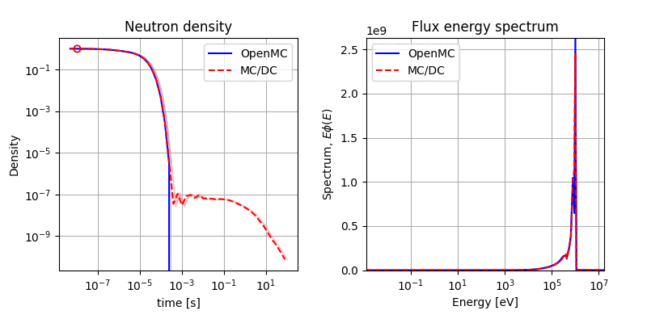
MC/DC Verification: Continuous energy physics
High-energy pulse in LEU pin cell → neutron slowing-down wave
Compared to OpenMC result
Disagreement due to the missing
some inelastic reactions, and
high-fidelity scattering models [S(alpha, beta), …] in MC/DC.
OpenMC seems not tracking delayed neutrons yet.
UO₂ (2.4% enrichment)
H₂O + Boron

Slide 25
Traceback (most recent call last):
File "/home/joamorga/workspace/MCDC/examples/fixed_source/slab_absorbium/input.py", line 48, in <module>
mcdc.run()
File "/home/joamorga/workspace/MCDC/mcdc/main.py", line 61, in run
mcdc = prepare()
^^^^^^^^^
File "/home/joamorga/workspace/MCDC/mcdc/main.py", line 191, in prepare
build_gpu_progs()
File "/home/joamorga/workspace/MCDC/mcdc/loop.py", line 1208, in build_gpu_progs
process_sources = make_gpu_process_sources(False)
^^^^^^^^^^^^^^^^^^^^^^^^^^^^^^^
File "/home/joamorga/workspace/MCDC/mcdc/loop.py", line 1112, in make_gpu_process_sources
spec = adapt.harm.RuntimeSpec(spec_name,adapt.state_spec,base_fns,async_fns)
^^^^^^^^^^^^^^^^^^^^^^^^^^^^^^^^^^^^^^^^^^^^^^^^^^^^^^^^^^^^^^^^^^^^^
File "/home/joamorga/workspace/harmonize/harmonize.py", line 1100, in __init__
self.generate_code()
File "/home/joamorga/workspace/harmonize/harmonize.py", line 1564, in generate_code
ptx_text = extern_device_ptx(fn,self.type_map)
^^^^^^^^^^^^^^^^^^^^^^^^^^^^^^^^^^^
File "/home/joamorga/workspace/harmonize/harmonize.py", line 636, in extern_device_ptx
ptx_text, res_type = device_ptx(func)
^^^^^^^^^^^^^^^^
File "/home/joamorga/workspace/harmonize/harmonize.py", line 121, in device_ptx
ptx, res_type = cuda.compile_ptx_for_current_device(func,fn_arg_ano(func),device=True,debug=DEBUG,opt=(not DEBUG))
^^^^^^^^^^^^^^^^^^^^^^^^^^^^^^^^^^^^^^^^^^^^^^^^^^^^^^^^^^^^^^^^^^^^^^^^^^^^^^^^^^^^^^^^^^^^^^^^^^
File "/home/joamorga/miniconda3/envs/hip/lib/python3.11/site-packages/numba/hip/compiler.py", line 423, in compile_llvm_ir_for_current_device
return compile_llvm_ir(
^^^^^^^^^^^^^^^^
File "/home/joamorga/miniconda3/envs/hip/lib/python3.11/site-packages/numba/core/compiler_lock.py", line 35, in _acquire_compile_lock
return func(*args, **kwargs)
^^^^^^^^^^^^^^^^^^^^^
File "/home/joamorga/miniconda3/envs/hip/lib/python3.11/site-packages/numba/hip/compiler.py", line 354, in compile_llvm_ir
cres: CompileResult = compile_hip(
^^^^^^^^^^^^
File "/home/joamorga/miniconda3/envs/hip/lib/python3.11/site-packages/numba/core/compiler_lock.py", line 35, in _acquire_compile_lock
return func(*args, **kwargs)
^^^^^^^^^^^^^^^^^^^^^
File "/home/joamorga/miniconda3/envs/hip/lib/python3.11/site-packages/numba/hip/compiler.py", line 262, in compile_hip
cres = compiler.compile_extra(
^^^^^^^^^^^^^^^^^^^^^^^
File "/home/joamorga/miniconda3/envs/hip/lib/python3.11/site-packages/numba/core/compiler.py", line 770, in compile_extra
return pipeline.compile_extra(func)
^^^^^^^^^^^^^^^^^^^^^^^^^^^^
File "/home/joamorga/miniconda3/envs/hip/lib/python3.11/site-packages/numba/core/compiler.py", line 461, in compile_extra
return self._compile_bytecode()
^^^^^^^^^^^^^^^^^^^^^^^^
File "/home/joamorga/miniconda3/envs/hip/lib/python3.11/site-packages/numba/core/compiler.py", line 529, in _compile_bytecode
return self._compile_core()
^^^^^^^^^^^^^^^^^^^^
File "/home/joamorga/miniconda3/envs/hip/lib/python3.11/site-packages/numba/core/compiler.py", line 508, in _compile_core
raise e
File "/home/joamorga/miniconda3/envs/hip/lib/python3.11/site-packages/numba/core/compiler.py", line 495, in _compile_core
pm.run(self.state)
File "/home/joamorga/miniconda3/envs/hip/lib/python3.11/site-packages/numba/core/compiler_machinery.py", line 368, in run
raise patched_exception
File "/home/joamorga/miniconda3/envs/hip/lib/python3.11/site-packages/numba/core/compiler_machinery.py", line 356, in run
self._runPass(idx, pass_inst, state)
File "/home/joamorga/miniconda3/envs/hip/lib/python3.11/site-packages/numba/core/compiler_lock.py", line 35, in _acquire_compile_lock
return func(*args, **kwargs)
^^^^^^^^^^^^^^^^^^^^^
File "/home/joamorga/miniconda3/envs/hip/lib/python3.11/site-packages/numba/core/compiler_machinery.py", line 311, in _runPass
mutated |= check(pss.run_pass, internal_state)
^^^^^^^^^^^^^^^^^^^^^^^^^^^^^^^^^^^
^^^^^^^^^^^^^^^^^^^^^^^^^^^^^^^^^^^
File "/home/joamorga/miniconda3/envs/hip/lib/python3.11/site-packages/numba/core/compiler_machinery.py", line 273, in check
mangled = func(compiler_state)
^^^^^^^^^^^^^^^^^^^^
File "/home/joamorga/miniconda3/envs/hip/lib/python3.11/site-packages/numba/core/typed_passes.py", line 110, in run_pass
typemap, return_type, calltypes, errs = type_inference_stage(
^^^^^^^^^^^^^^^^^^^^^
File "/home/joamorga/miniconda3/envs/hip/lib/python3.11/site-packages/numba/core/typed_passes.py", line 91, in type_inference_stage
errs = infer.propagate(raise_errors=raise_errors)
^^^^^^^^^^^^^^^^^^^^^^^^^^^^^^^^^^^^^^^^^^
File "/home/joamorga/miniconda3/envs/hip/lib/python3.11/site-packages/numba/core/typeinfer.py", line 1086, in propagate
raise errors[0]
numba.core.errors.TypingError: Failed in hip mode pipeline (step: nopython frontend)
No implementation of function Function(<function do_nothing_12 at 0x7fd11f3d02c0>) found for signature:
>>> do_nothing_12(nestedarray(int64, (1,)), Literal[int](0), Literal[int](1))
There are 2 candidate implementations:
- Of which 1 did not match due to:
Overload in function 'jit_func': File: ../../../../../../workspace/MCDC/examples/fixed_source/slab_absorbium/<string>: Line 0.
With argument(s): '(nestedarray(int64, (1,)), int64, int64)':
Rejected as the implementation raised a specific error:
TypingError: Failed in hip mode pipeline (step: nopython frontend)
No implementation of function Function(<class 'numba.hip.typing_lowering.hipdevicelib.hipsource.add'>) found for signature:
>>> add(nestedarray(int64, (1,)), int64, int64)
There are 2 candidate implementations:
- Of which 2 did not match due to:
Type Restricted Function in function 'add': File: unknown: Line unknown.
With argument(s): '(nestedarray(int64, (1,)), int64, int64)':
No match for registered cases:
* (int32,) -> UniTuple(int32 x 2)
* (uint32,) -> UniTuple(uint32 x 2)
* (uint64,) -> UniTuple(uint64 x 2)
* (uint64,) -> UniTuple(uint64 x 2)
* (float32,) -> UniTuple(float32 x 2)
* (float64,) -> UniTuple(float64 x 2)
During: resolving callee type: Function(<class 'numba.hip.typing_lowering.hipdevicelib.hipsource.add'>)
During: typing of call at /home/joamorga/workspace/MCDC/mcdc/adapt.py (386)
File "../../../mcdc/adapt.py", line 386:
def global_add(ary,idx,val):
return cuda.atomic.add(ary,idx,val)
^
raised from /home/joamorga/miniconda3/envs/hip/lib/python3.11/site-packages/numba/core/typeinfer.py:1086
- Of which 1 did not match due to:
Overload in function 'jit_func': File: ../../../../../../workspace/MCDC/examples/fixed_source/slab_absorbium/<string>: Line 0.
With argument(s): '(nestedarray(int64, (1,)), Literal[int](0), Literal[int](1))':
Rejected as the implementation raised a specific error:
TypingError: Failed in hip mode pipeline (step: nopython frontend)
No implementation of function Function(<class 'numba.hip.typing_lowering.hipdevicelib.hipsource.add'>) found for signature:
>>> add(nestedarray(int64, (1,)), Literal[int](0), Literal[int](1))
There are 2 candidate implementations:
- Of which 2 did not match due to:
Type Restricted Function in function 'add': File: unknown: Line unknown.
With argument(s): '(nestedarray(int64, (1,)), int64, int64)':
No match for registered cases:
* (int32,) -> UniTuple(int32 x 2)
* (uint32,) -> UniTuple(uint32 x 2)
* (uint64,) -> UniTuple(uint64 x 2)
* (uint64,) -> UniTuple(uint64 x 2)
* (float32,) -> UniTuple(float32 x 2)
* (float64,) -> UniTuple(float64 x 2)
During: resolving callee type: Function(<class 'numba.hip.typing_lowering.hipdevicelib.hipsource.add'>)
During: typing of call at /home/joamorga/workspace/MCDC/mcdc/adapt.py (386)
File "../../../mcdc/adapt.py", line 386:
def global_add(ary,idx,val):
return cuda.atomic.add(ary,idx,val)
^
raised from /home/joamorga/miniconda3/envs/hip/lib/python3.11/site-packages/numba/core/typeinfer.py:1086
During: resolving callee type: Function(<function do_nothing_12 at 0x7fd11f3d02c0>)
During: typing of call at /home/joamorga/workspace/MCDC/mcdc/loop.py (966)
File "../../../mcdc/loop.py", line 966:
def make_work(prog: nb.uintp) -> nb.boolean:
<source elided>
idx_work = adapt.global_add(mcdc["mpi_work_iter"],0,1)

Slide 26
MC/DC current core capabilities
Multigroup physics
Capture
Isotropic scattering
Fission (prompt and delayed)
Continuous energy physics [new!]
NJOY generated point-wise data,
Room temperature
Assumed linear interpolation
Capture (MT=102-117)
Fission (prompt and delayed)
Scattering (non-capture & non-fission)
Isotropic elastic scattering in COM
Free gas, constant XS model for thermal scattering
Support almost all nuclides
Geometry
Surface-tracking
Quadric CSG surface
Multi-level lattice
Time-dependent planar surfaces
Simulation modes
Fixed-source (time-dependent)
k-Eigenvalue
Running modes: Python, Numba
Parallel support
MPI
Numba-CUDA (via Harmonize)
Domain decomposition
Reproducibility (via hash-based RNG seeding)

